Slide 1
System-Level Design of Adaptive Wireless Transceivers including Antenna Arrays
Tim Reeves Application Engineer

Slide 2
What material are we going to cover today?
Three topics that we are going to cover today, each session is one hour long covering the following topics:
Top down design of RF transceivers: From spreadsheet computations to fast RF simulation
Antenna and antenna array design for wireless engineers
End-to-End Modelling of Wireless Systems

Slide 3
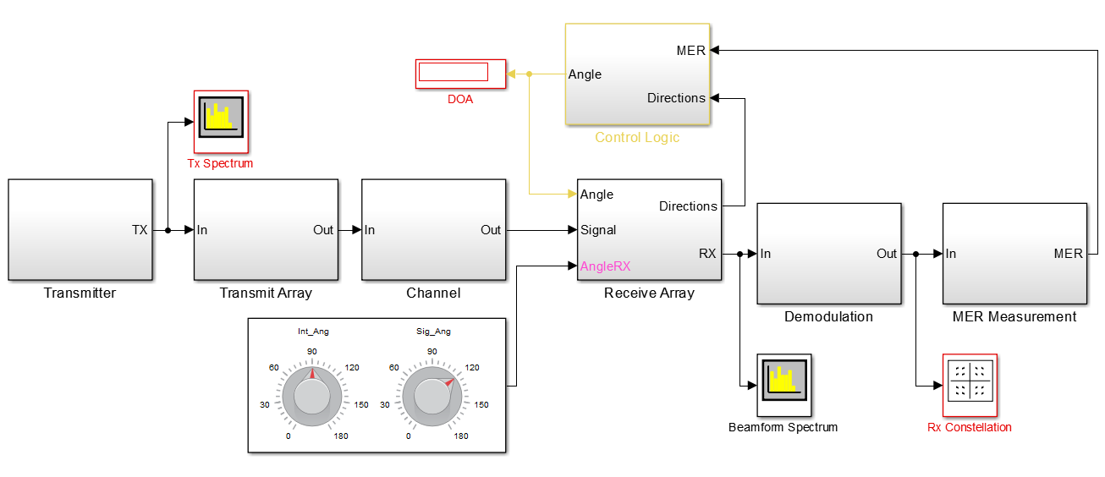
What sort of system model could ultimately be developed using MathWorks tools?

Slide 4
What are some of the key things included in this model?
Antenna Modeling:
Isolated element and superposition principles used in modeling the receive array.
Antenna element interaction as well as impedance loading included in receive array
RF Modeling:
RF receiver model that includes, linear, non-linear and noise behavior
Matching network for receive antennas
RF components described by measured data (S-parameters)
Beamforming:
Baseband DSP algorithms used to determine error rates and determine beamforming angles

Slide 5
Part One:
Top down design of RF transceivers: From spreadsheet computations to fast RF simulation

Slide 6
How do MathWorks Tools Integrate into a “Top-Down” Communications System Design Flow?
SPECIFICATION
Multi-domain algorithm development
Elaborate ‘Golden’ reference model derived from specification
Study architectural trade-offs between analog and digital systems
Determine integrated system performance
DESIGN
Algorithms
Digital
Analog
Verification
Co-simulation with 3rd party tools
Testbench generation
Integration with test and measurement equipment
Fixed-Point
Physical
TEST & VERIFICATION
IMPLEMENTATION
VHDL, Verilog
Spice-like
FPGA
ASIC
RF
SMPS
Implementation and prototyping
Architectural models that are representative of board level implementations.
Synthesizable HDL code generation
INTEGRATION
Notes:
How do MathWorks Tools fit in the overall mixed-signal design and verification space?
First of all, MathWorks provide a platform for system-level design and simulation. MathWorks tools are complementary to the tools used for IC implementation (Cadence, Synopsys, Mentor Graphics) and do not provide an alternative to these tools.
MathWorks tools provide a natural environment for building multi-domain system-level models, integrating analog, digital, mixed-signal, RF and supervisory logic expressed as HW or SW. A large set of libraries and a fast simulation environment make easier to build system-level models making use of graphical and textual entries for maximum expressivity.
Naturally MATLAB and Simulink provide an environment to build behavioral models and validate the real-number abstraction. These models can then be brought downstream for integration in the verification workflow.
MathWorks tools link to the downstream tools by means of cosimulation or code-generation. This supports the validation of the system-level behavioral models against the IC implementation, and allows building expressive system-level testbenches for the mixed-signal IP verification.
The link with the test and measurement equipment and the ability to use FPGAs for rapid prototyping provide even more tools for rapidly verifying the models and validate the IC.
Automatic code generation for digital HW and SW/Firmware provide a fast route towards implementation for the part of the design that support automatic model transformation (obviously not the analog part).

Slide 7
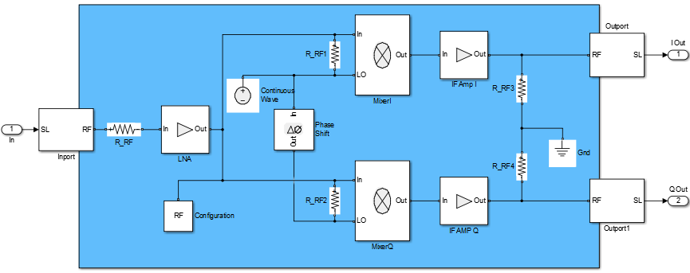
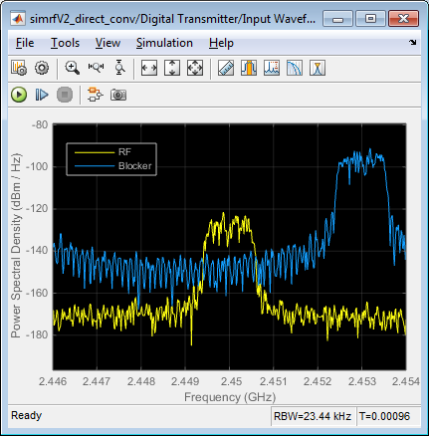
How do we integrate RF Behavior with MathWorks tools?
Integrating RF behavior into Communications system models will likely be your biggest integration challenge.
RF behavior is included via a physical modeling platform that is an addition to Simulink.
RF systems are realized in a manner similar to that of circuit simulators that you would find in Cadence Virtuoso, KeySight’s ADS circuit simulator etc..

Slide 8
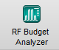
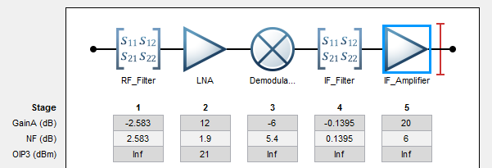
What part of the design do we want to begin with?
You often start with an Excel Spreadsheet for doing Budget calculations; let’s do this with a new MATLAB application, RF Budget Analyzer
What benefit does it bring to you?
Implements power / noise / IP3 RF link budget analytical computations
Better than similar custom-made spreadsheets – takes into account mismatches
Generates models / testbenches for SimRF Circuit Envelope simulations
Provides consistency between analytical and simulation results
Supports the “top-down” design workflow

Slide 9
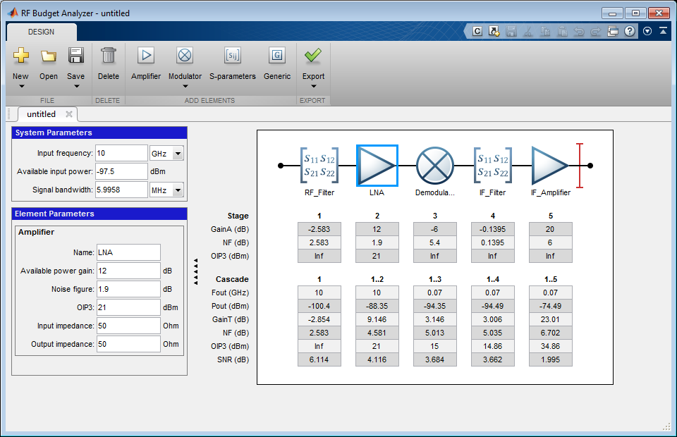
Add RF components
Export to SimRF
RF Cascade
Component specifications
Cascade Budget Analysis
Notes:
RF Budget Analyzer
Once you start the app, you can add components and build a high level chain. You can specify the data sheet parameters of the components, or import measurements such as 2-port Touchstone files.
The app computes the power/noise/ip3 budget at each stage of the chain taking into account impedance mismatches. This allows the designers to decide how to partition the system and define the high-level specs of the different components.
When the analysis is completed and deemed satisfactory, you can automatically generate a SimRF model to validate the system performance using simulation.
This allows you to integrate RF front-end into more complex systems, adding signal processing and control algorithms and testing the RF front-end in different scenarios. Moreover the RF model can be extended to describe the RF architecture in a more accurate way, or by adding imperfections that cannot be taken into account using analytical computations.

Slide 10
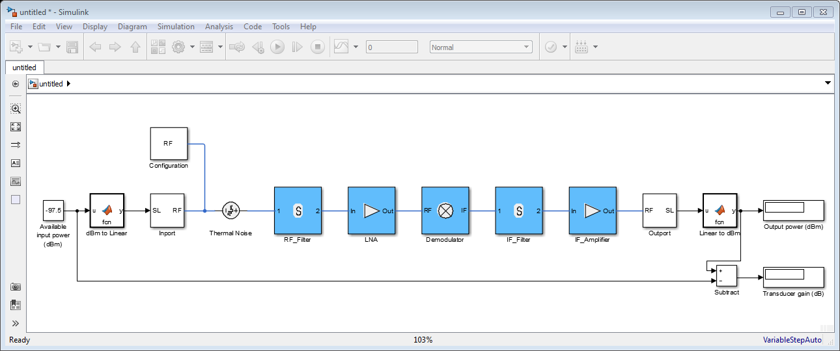
How do I export a SimRF model?
The application has an option to export a simple Simulink testbench to measure power and gain
Tstop = 0 → static analysis (harmonic balance)
Input/output ports and RF configuration are setup correctly
Copy and paste to include RF model in more complex set ups
Notes:
Export to SimRF
You can build a simple SimRF testbench to validate expected gain and power levels of your chain. The automatically generated model can be easily embedded into more complex system
models.
Notice that the input/output ports are set up with the correct frequencies, and the configuration block uses a very wide simulation bandwidth. Notice also that the modulator/demodulators integrate ideal image rejection filters to reproduce the analytical results. When the RF designers implement these blocks they will have to design the filters accordingly.
In order to speed up simulation, you might want to reduce the harmonic order or to reassess the simulation bandwidth. As this depends on the actual power level of the input signal and on the operating conditions, this is not something that SimRF can automatically do.

Slide 11
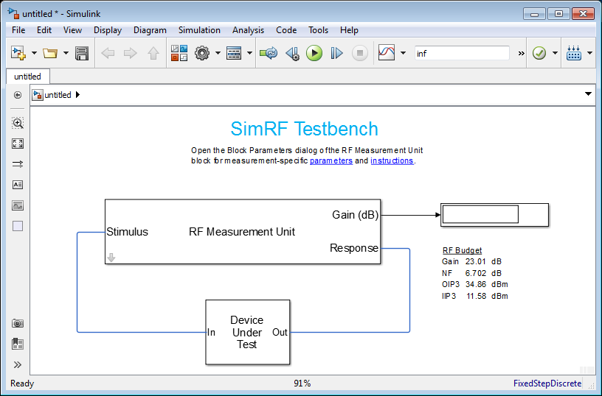
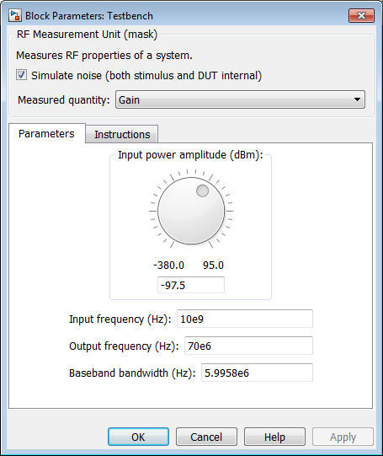
How can I verify that my SimRF model reproduces the expected theoretical results?
There is also an option to generate a more sophisticated Simulink testbench to measure gain, noise and IP3 using time domain simulation
When making noise measurements, follow the same practices that you would in the lab, i.e. make sure that you use narrow-band simulation to get accurate narrowband results (e.g. spot noise)
You will be able to validate that the RF front end is behaving as expected
Notes:
Export to SimRF Testbench
This testbench is a bit more involved and requires DSP System Toolbox. With this testbench you can measure the gain, noise and IP3 of the chain. You can also inspect and understand how these measurements are done in the time domain.
In case of filtering elements, the gain, noise and IP3 will depend on the bandwidth of the measurement. For this reason, you might have to decrease the bandwidth of the signal measurement in order to measure spot (narrowband) properties.

Slide 12
Let’s start with understanding how to do RF System modeling in Simulink
What would you like to be able to do with a RF behavioral modeling tool?
Design and define both the architecture and the specs of the RF components
Test and debug the implementation of the transceiver before going in the lab
Integrate RF front ends with adaptive algorithms such as DPD, AGC
Provide a model of the RF transceiver to your colleagues and customers

Slide 13

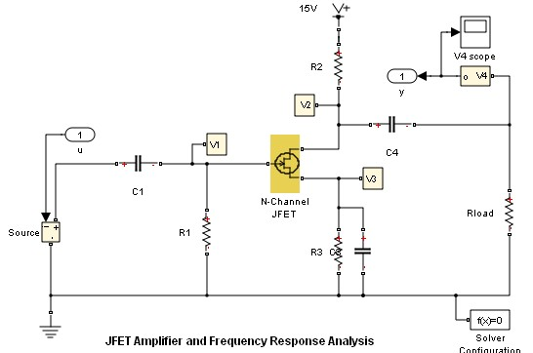
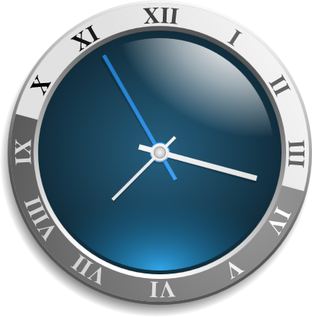
What do you need from a RF System Simulator?
RF and analog behavioral models that capture linear, non-linear and noise performance
Ability to develop control, calibration and signal processing algorithms
Fast simulation of baseband + RF systems
Radio Frequency
Signals
Small simulation time-step
Long Simulation Runs
~10psec
~5GHz

Slide 14
Section Wrap-up
We discussed how MathWorks tools can be used in a “top-down” design workflow for RF systems and how that workflow tightly corresponds to commonly used design flows, in that:
You have access to a MATLAB application that allows you to compute RF budgets in a manner that is comparable to work that you do with Excel spreadsheets.
From this MATLAB application, you can generate Simulink-based RF systems for use in larger communication system simulations.
You also have the option to generate Simulink test benches that generate RF Budget results that compare favorably to the analytical results.

Slide 15
Let’s revisit our system model that we were looking at before.

Slide 16
Part Two:
Antenna and antenna array design for wireless engineers

Slide 17
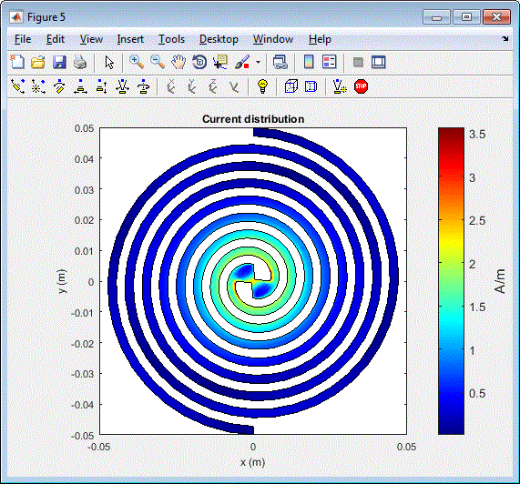
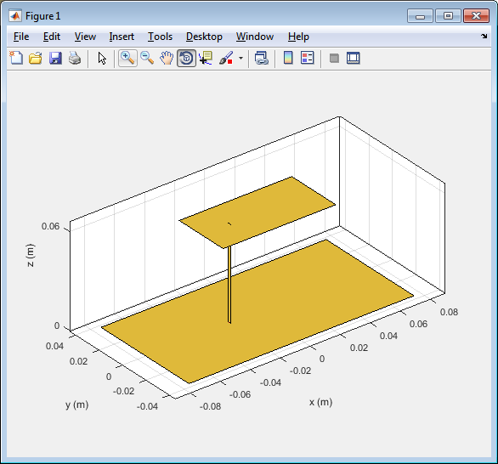
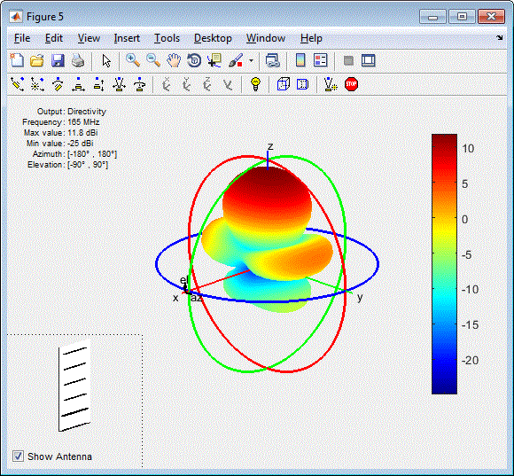
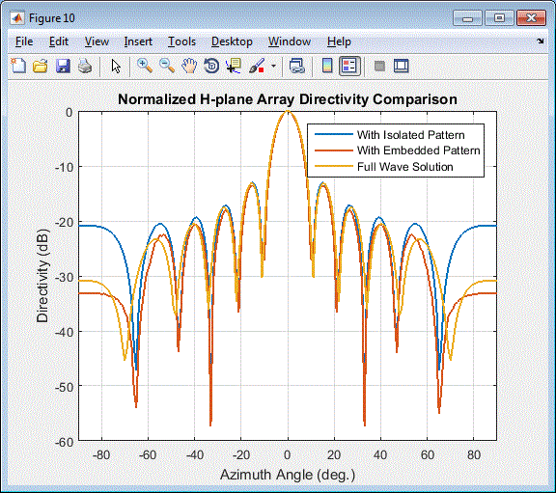
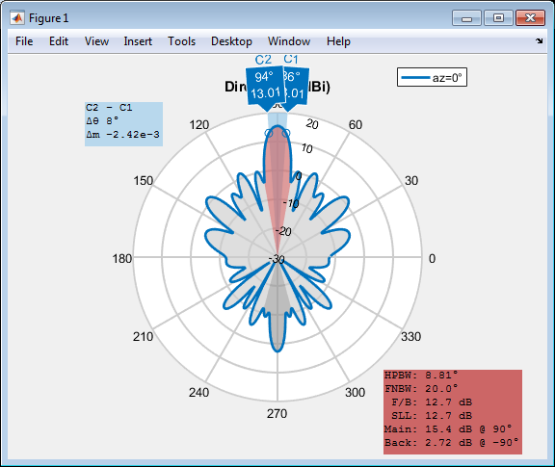
How can I model antennas using MathWorks tools?
Antenna Toolbox
Easy design
Library of parameterized antenna elements
Functionality for the design of antenna arrays
No need for full CAD design
Rapid simulation setup
Method of Moments field solver for port, field, and surface analysis
No need to be an EM expert
Seamless integration
Model the antenna together with signal processing algorithms
Rapid iteration of different antenna scenarios for radar and communication systems design

Slide 18
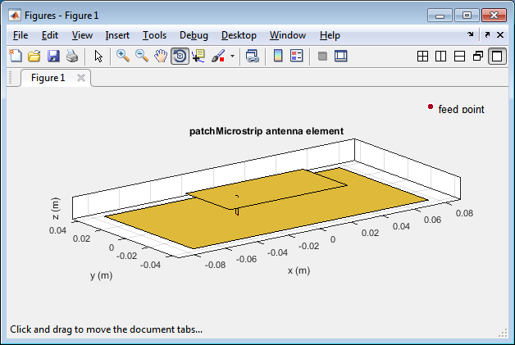
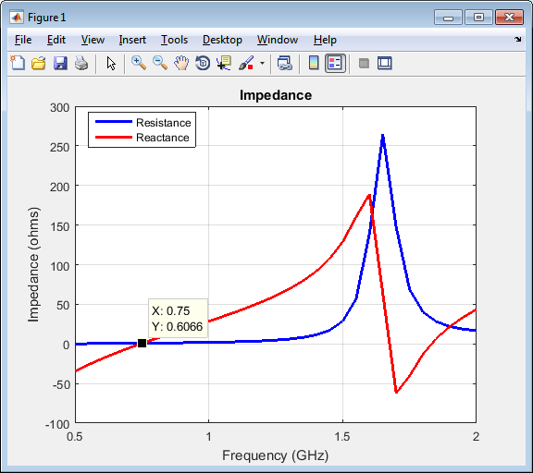
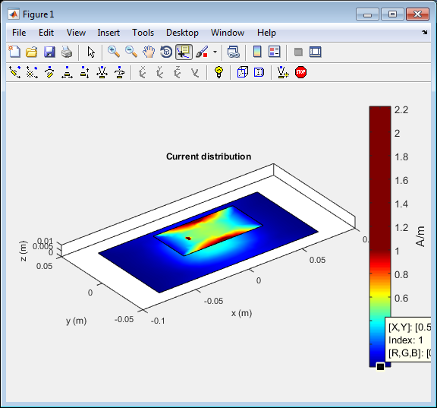
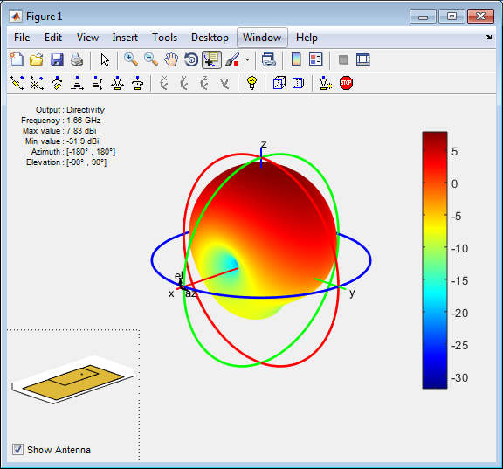
Antenna Toolbox Demo Design and analysis of one antenna element, in just 5 lines of MATLAB code
>> p = patchMicrostrip
>> p.Height = 0.01;
>> impedance(p, (500e6:10e6:2e9));
>> current(p, 1.66e9);
>> pattern(p, 1.66e9);

Slide 19
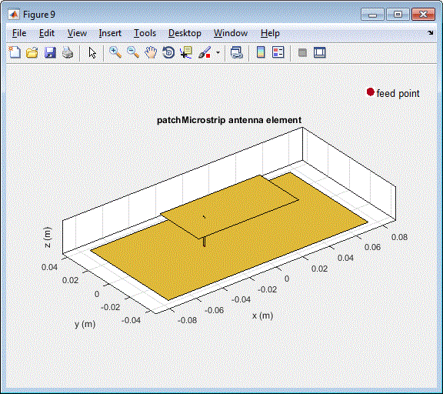
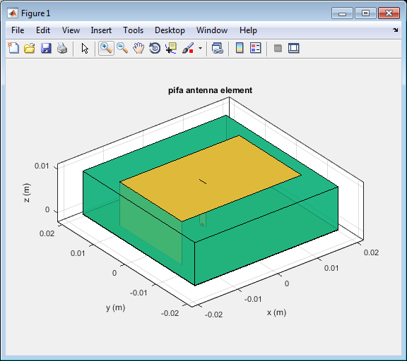
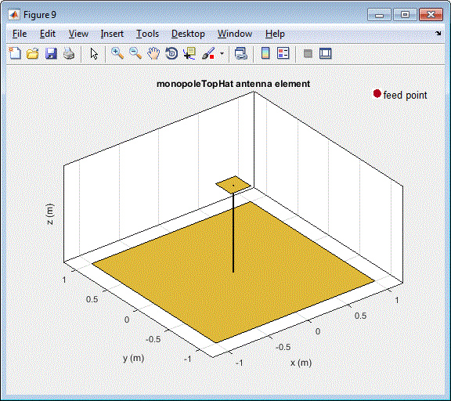
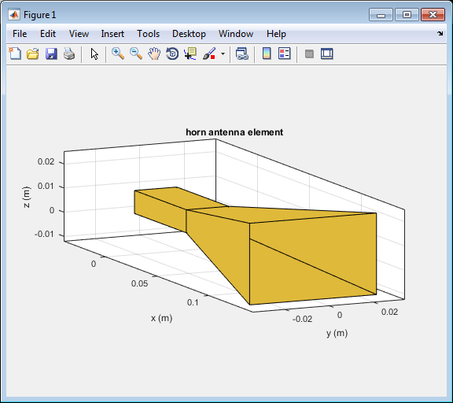
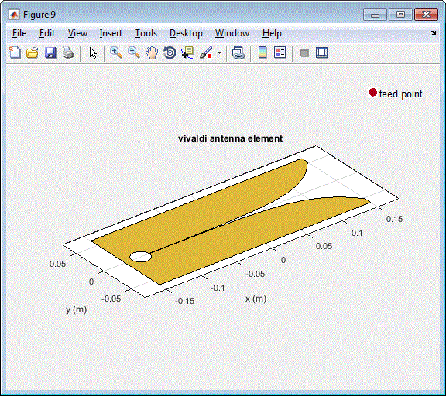
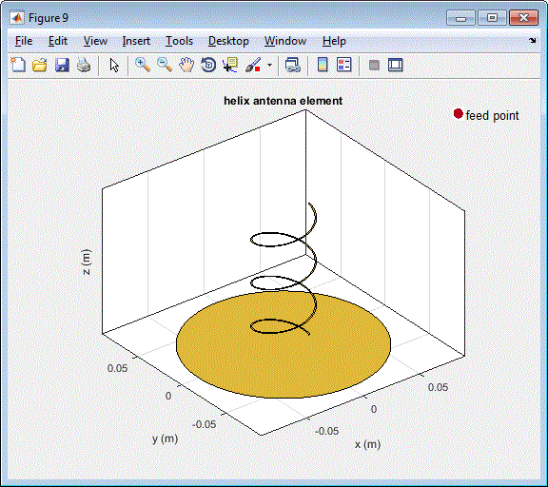
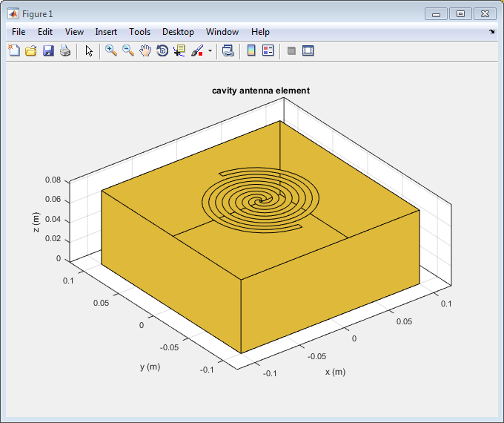
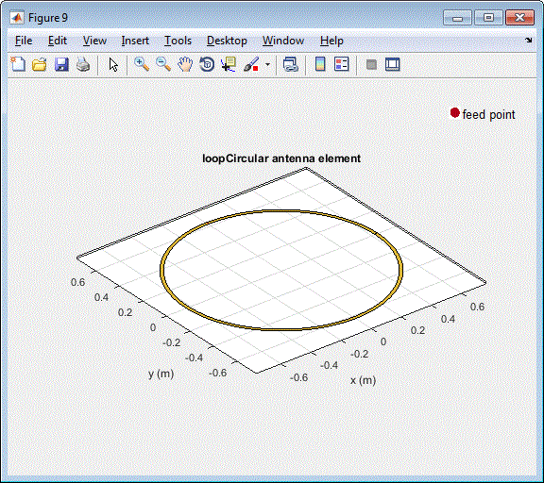
What radiating structures are part of Antenna Toolbox?
Dipole antennas
Dipole, Vee, Folded, Meander, Triangular bowtie, Rounded bowtie
Monopole antennas
Monopole, Top hat, Inverted-F, inverted-L, Helix
Patch antennas
Microstrip patch, PIFA
Spirals
Equiangular, Archimedean
Loops
Circular, rectangular
Backing structures
Reflector and cavity
Other common antennas
Yagi Uda, Slot, Vivaldi, Biquad, Horn

Slide 20
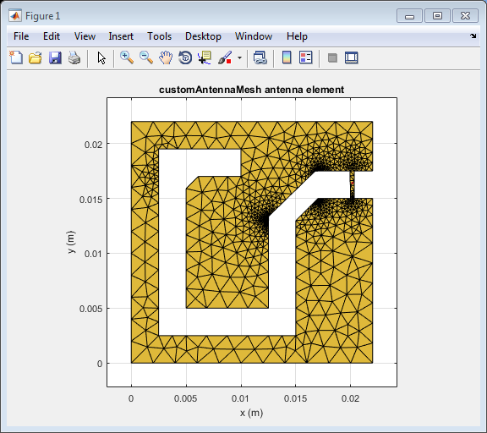
What if my Antenna is not included in the Library?
Define your custom planar structure
Define the antenna geometry using PDE Toolbox
Define the mesh using MATLAB delaunayTriangulation
Use third party tools to generate a mesh structure
Import 2D mesh with Antenna Toolbox
Define the feeding point
Analyse the antenna
Integrate your custom antenna
Define a backing structure
Define a dielectric structure
Build an array with custom elements

Slide 21
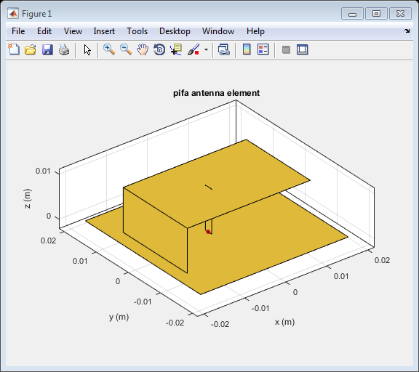

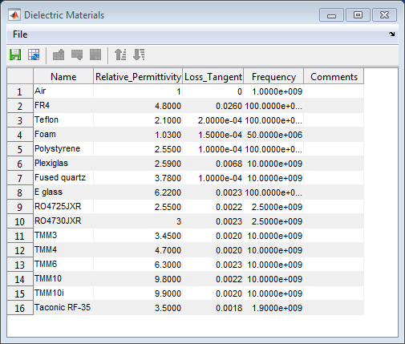
What if my Antenna is Mounted on a Dielectric Substrate?
Free space (isolation)
Antenna are often mounted on substrates
Dielectric properties:
Dielectric properties affect resonant frequency, bandwidth, efficiency, pattern …
Use the dielectric catalogue listing existing materials
Define your own dielectric material
Dielectric | Relative permittivity | Loss Tangent
Air | 1 | 0
Other | >1 (typically <10) | >0 (typically ~1e-3)
“metal” antenna
(ideal conductor)
Dielectric substrate

Slide 22
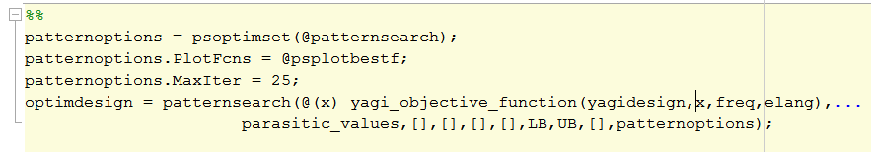
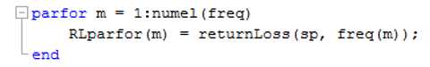
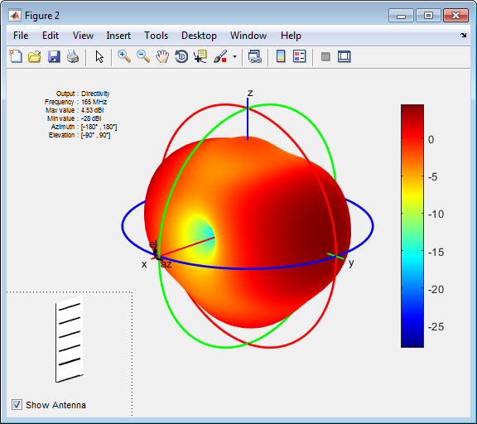
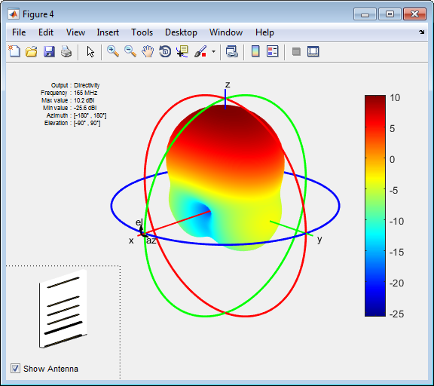
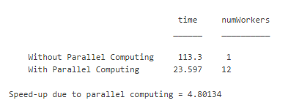
How can I efficiently include dielectric properties while not dramatically increasing my design time?
Modelling the dielectric substrate can slow down analysis time:
Use antennas in free space for first-cut design
Combine with optimization routines to rapidly determine a suitable starting point
Use parallel computing to speed up wideband frequency analysis
Poor directivity
Optimized pattern

Slide 23
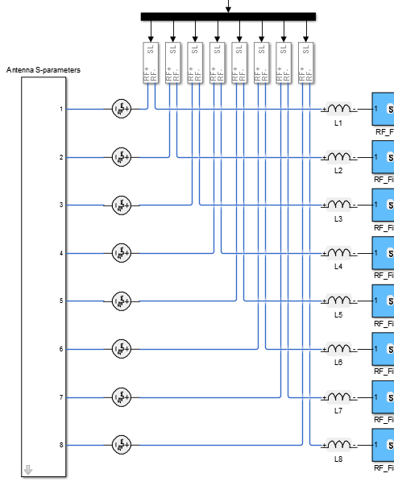
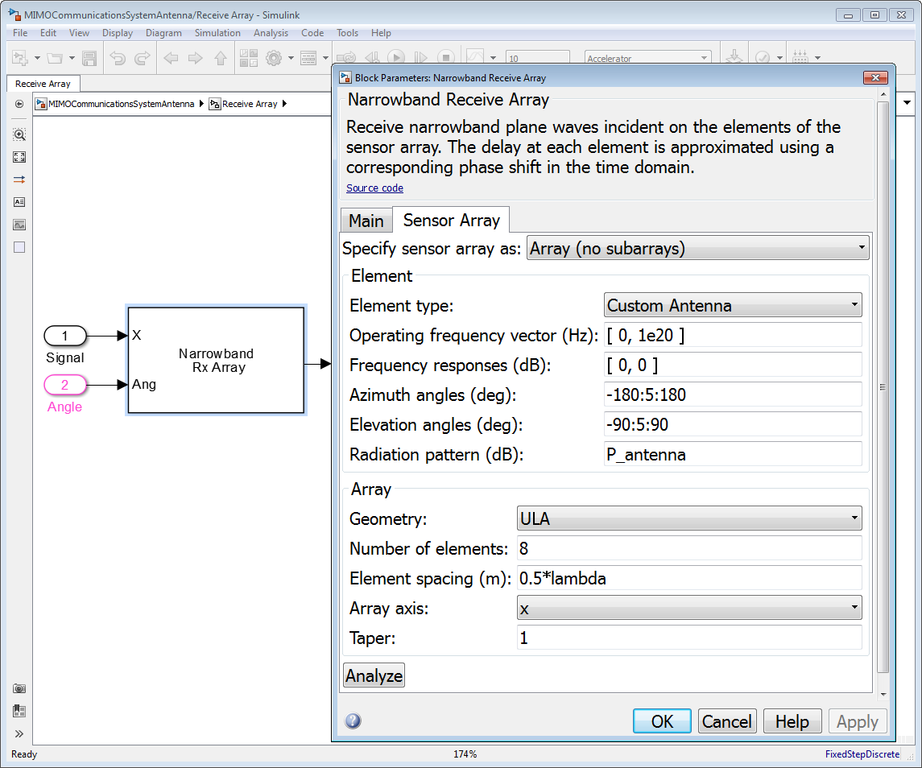
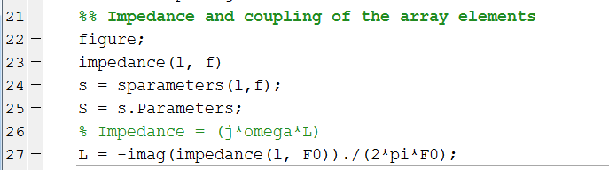
How are results obtained using Antenna Toolbox incorporated into the downstream workflow?
Port (RF / Microwave behaviour)
Input Impedance, Resonance, Reflection Coefficient, Return Loss, Voltage Standing Wave Ratio (VSWR), Bandwidth
Field (Antenna behaviour)
Radiation Pattern, Beamwidth, E-Plane and H-Plane, Polarization, Axial Ratio

Slide 24
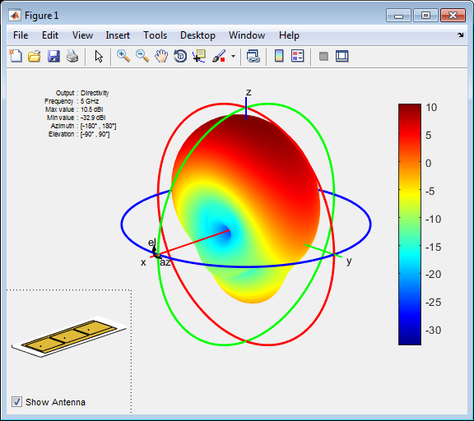
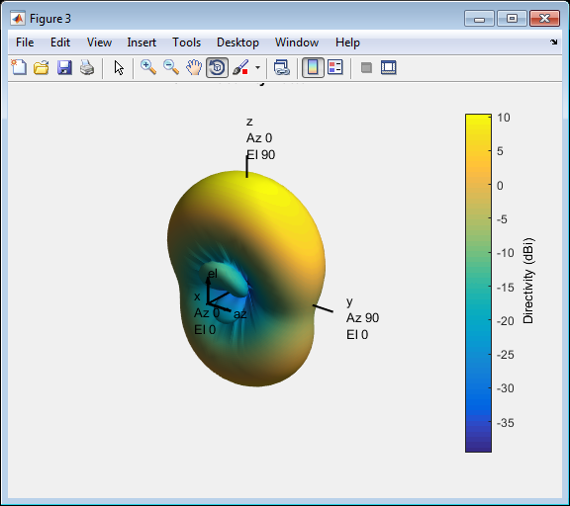
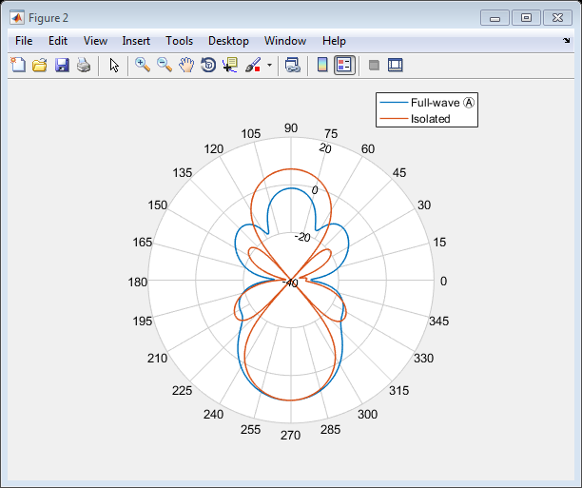
What if you Need to Take into Account …
Coupling effects in between antenna elements?
Edge effects?
Pattern multiplication of the isolated element is not sufficient!
Isolated element
pattern superposition
Full wave
Comparison

Slide 25
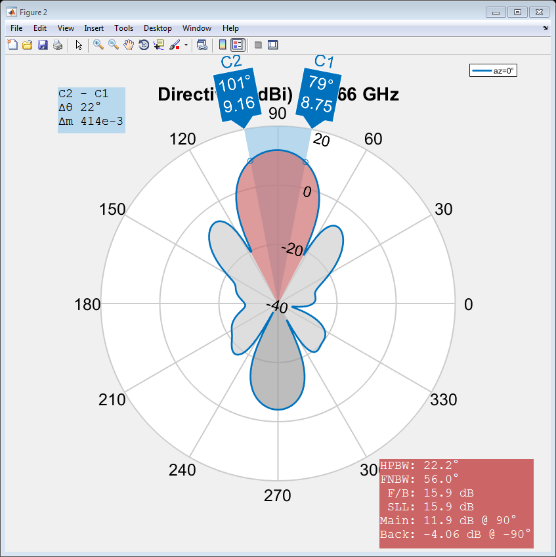
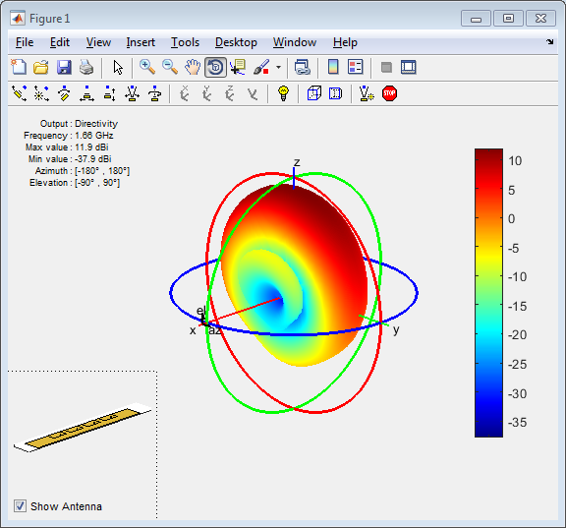
How can I construct an Antenna Array using Antenna Toolbox?
>> a = linearArray
>> a.Element = p;
>> a.ElementSpacing = 0.1;
>> a.NumElements = 4;
>> show(a);
>> patternElevation(a, 1.66e9,0);

Slide 26
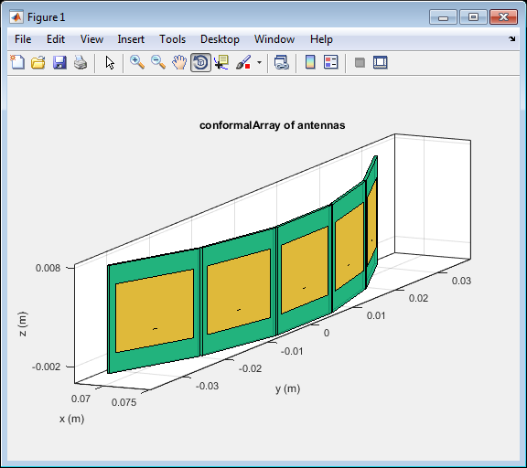
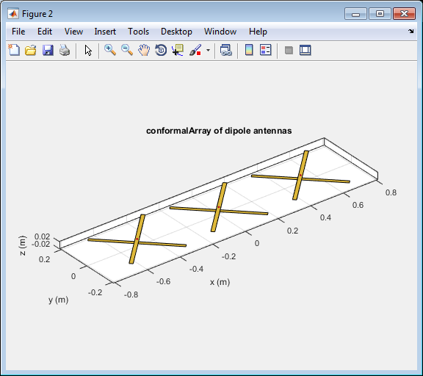
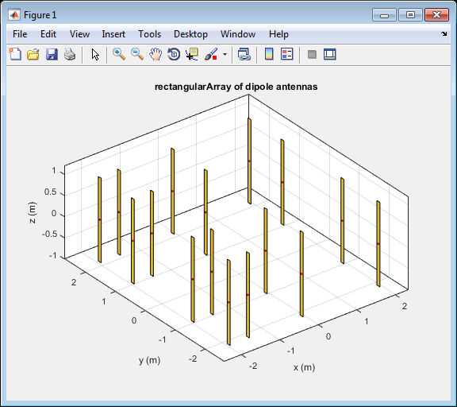
What if I Need to Customize my Array?
Build regular arrays where you can change the properties of individual elements (rotation, size, tapering)
Describe conformal (heterogeneous) arrays in terms of element type and arbitrary position
>> arr = conformalArray;
>> d = dipole;
>> b = bowtieTriangular;
>> arr.Element = {d, b};
>> arr.ElementPosition(1,:) = [0 0 0];
>> arr.ElementPosition(2,:) = [0 0.5 0];

Slide 27
Why do I want to import an antenna element pattern into Phased Array system toolbox?
An isolated antenna element pattern can be imported into Phased Array system toolbox to estimate the array pattern
Phased Array System Toolbox provides algorithms and tools to design, simulate, and analyze phased array signal processing systems
Beamforming
Estimation of Direction of Arrival
...
% Import antenna element in Phased Array
>> myantenna = dipole;
>> myURA = phased.URA;
>> myURA.Element = myantenna;
Antenna element (isolated)
Phased Array System Toolbox
antenna array

Slide 28
Modelling the Array Radiation Pattern in Practice
Are the antenna elements spaced far apart?
no
yes
Compute the isolated element pattern and apply pattern superposition
What is the size of the array?
<10
>10x10
Homogenous array
Small
Mid
Large
Compute the pattern for each element embedded in the array
Compute the pattern for the central and the edge (corner) element embedded in the array
Compute the pattern for the central element with the infinite array approach
Heterogeneous array
Validate (when possible)
with full EM simulation

Slide 29
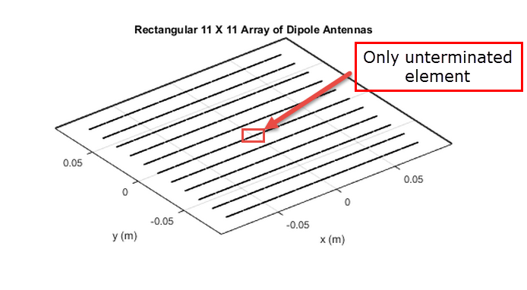
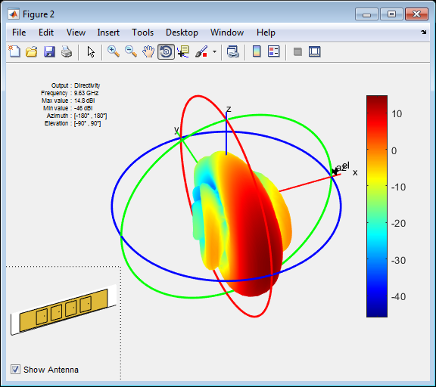
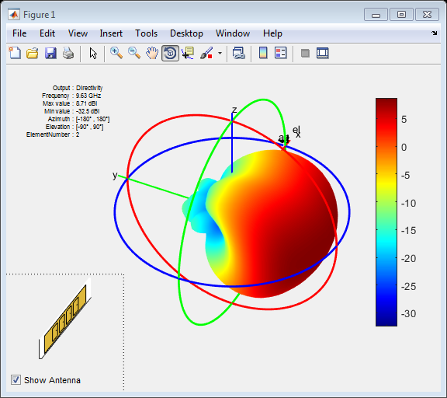
How can I model element interaction without doing fullwave EM simulation?
Calculate the embedded element pattern and use the same concepts as mentioned before for doing pattern multiplication.
Full wave
Embedded element
pattern(l, 10e9);
pattern(l, 10e9, ...
'ElementNumber',2);

Slide 30




What if my Array is Really Large?
Infinite Array Analysis
Repeat unit cell infinitely
Impedance and pattern become function of frequency and scan angle
Ignore edge effects
Captures mutual coupling
Validate with full wave simulation on smaller arrays
Scan Impedance @10GHz
Scan Impedance
Power Pattern
0deg Azimuth
45deg Azimuth
90deg Azimuth
0deg Azimuth 45deg Elevation

Slide 31




Where can we noticeably see the interaction between elements in an antenna array?
Adjacent structures affect the impedance of an antenna embedded with an array
Resonant frequency
Magnetic coupling in between antenna elements
Isolated element
Active element
Full array
impedance(l, freq);
S=sparameters(l, freq);
impedance(p, freq);

Slide 32



How about we do an example to see everything we just saw in action?

Slide 33
How do I incorporate antenna and antenna arrays into system simulations?
An isolated antenna element pattern can be imported into Phased Array system toolbox to estimate the array pattern
Phased Array System Toolbox provides algorithms and tools to design, simulate, and analyze phased array signal processing systems
Beamforming
Estimation of Direction of Arrival

Slide 34



How does this tie-in with our wireless system model?

Slide 35
Section Wrap Up
We discussed how MathWorks tools can be used in a “top-down” design workflow for antennas and antenna arrays. Specific designs tasks that we highlighted:
Characterization, design and analysis of individual antenna elements.
How Antenna Toolbox and Phased Array system Toolbox can be used for integrating antenna element and array behavior into system simulations.
A methodology for determining the most efficient / effective antenna array analysis technique for a given array layout.

Slide 36
Part Three:
End-to-End Modelling of Wireless Systems

Slide 37
What are we going to cover during this part of the presentation?
How top-down design can aid your MIMO system development workflow
Study antenna array, RF, and signal processing system behaviour on baseband communication signals.
Elaborate system models in order to systematically study subsystem and component performance impacts.
How RF and antenna element and array behavior is included in system simulations
How to include channel as well as environmental impacts on signal transmission
Channel models and path loss capabilities in Communications System Toolbox
Clutter, channel and free space path modeling capabilities in Phased Array System Toolbox

Slide 38
How do MathWorks Tools Integrate into a “Top-Down” Communications System Design Flow?
SPECIFICATION
Multi-domain algorithm development
Elaborate ‘Golden’ reference model derived from specification
Study architectural trade-offs between analog and digital systems
Determine integrated system performance
DESIGN
Algorithms
Digital
Analog
Verification
Co-simulation with 3rd party tools
Testbench generation
Integration with test and measurement equipment
Fixed-Point
Physical
TEST & VERIFICATION
IMPLEMENTATION
VHDL, Verilog
Spice-like
FPGA
ASIC
RF
SMPS
Implementation and prototyping
Architectural models that are representative of board level implementations.
Synthesizable HDL code generation
INTEGRATION
Notes:
How do MathWorks Tools fit in the overall mixed-signal design and verification space?
First of all, MathWorks provide a platform for system-level design and simulation. MathWorks tools are complementary to the tools used for IC implementation (Cadence, Synopsys, Mentor Graphics) and do not provide an alternative to these tools.
MathWorks tools provide a natural environment for building multi-domain system-level models, integrating analog, digital, mixed-signal, RF and supervisory logic expressed as HW or SW. A large set of libraries and a fast simulation environment make easier to build system-level models making use of graphical and textual entries for maximum expressivity.
Naturally MATLAB and Simulink provide an environment to build behavioral models and validate the real-number abstraction. These models can then be brought downstream for integration in the verification workflow.
MathWorks tools link to the downstream tools by means of cosimulation or code-generation. This supports the validation of the system-level behavioral models against the IC implementation, and allows building expressive system-level testbenches for the mixed-signal IP verification.
The link with the test and measurement equipment and the ability to use FPGAs for rapid prototyping provide even more tools for rapidly verifying the models and validate the IC.
Automatic code generation for digital HW and SW/Firmware provide a fast route towards implementation for the part of the design that support automatic model transformation (obviously not the analog part).

Slide 39



How about we begin with a simplified system model?
Control logic to determine the beamforming angle
Modulation error ratio
Desired signal + interferer
Baseband Beamforming
Estimation of direction of arrival

Slide 40

What parts of the system have been developed to this point?

Slide 41



Let’s look at how we include the antenna array in the system model.
Full wave antenna array design
Antenna array model based on pattern superposition of the isolated element

Slide 42

How do we incorporate the near-field behaviour of the array?
Antenna coupling and loading (S-parameters)
Antenna matching
Gain, IP3, NF of the RF receiver

Slide 43
How do we incorporate individual subsystems into a larger system model? – Simulink + SimRF
What can I do with SimRF?
Design and define both the architecture and the specs of the RF components
Test and debug the implementation of the transceiver before going into the lab
Integrate RF front ends with adaptive algorithms such as DPD, AGC
Provide a model of the RF transceiver to your colleagues and customers

Slide 44
How can I get a good trade off between Simulation Speed and Modeling Fidelity?
Deal with RF complexity while
maintaining these characteristics:
Behavioral models that capture linear, non-linear and noise performance
Ability to develop control, calibration and signal processing algorithms
Models with high levels of abstraction
Solver that allows you to use larger time-steps
Signal
bandwidth
Equivalent
Baseband
Spectrum
Carrier
freq
Simulation speed
Spectrum
Circuit
Envelope
DC
Carrier 1
Carrier 2
freq
True
Pass-Band
Spectrum
Modeling fidelity
freq
Notes:
This is the spectral representation of the three modeling techniques to describe for which type of signals these simulation techniques apply.
True-pass band is suitable for ultra-wideband signals
Circuit envelope is suitable for narrowband signals over multiple simulation bandwidths.
Equivalent-baseband is suitable for narrowband signals with a single carrier.

Slide 45


Let’s look at a typical MIMO RF Receiver architecture.
Estimation of direction of arrival
Antenna coupling and loading (S-parameters)
Antenna matching network
RF and IF Filters described with Touchstone files
IF demodulation with image rejection
Non-linearity of the amplifiers
Thermal Noise

Slide 46
What types of channel modeling is available in MathWorks tools?
Communications System Toolbox:
Basic channel and RF propagation models
AWGN, Multipath Rayleigh and Rician fading and MIMO channels as well as Free Space Path Loss
LTE System Toolbox:
Reference channels for uplink and downlink channels
WLAN System Toolbox:
Reference and standard channels for 802.11ac and 802.11n
Phased Array System Toolbox

Slide 47




Phased Array System Toolbox Environment based Path Loss Models
Effect of Free Space
Effect of Rain
Effect of Fog
Effect of Gases
RF Propagation modeling example available
Notes:
For example, the PST has tools for modeling several RF propagation effects. These include free space path loss, atmospheric attenuation due to rain, fog and gas,

Slide 48



Phased Array System Toolbox Field Propagation
Two-Ray Channel
Result from phased.TwoRayChannel
Notes:
A two-ray channel used to analyze multipath propagation due to bounces on the ground based on the International Telecommunication Union's ITU-R specification

Slide 49



Antenna Toolbox Field Propagation
Notes:
Antenna Toolbox has a comprehensive catalog of antenna available… families of antenna include:
Dipole
Monopole
Model of helix from Antenna Toolbox, MoM solution, Field overlaid as heat map and E and H field vector plots

Slide 50

Antenna Toolbox Antenna Pattern on a Map
Antenna field strength example available
Notes:
Calculate an antenna's field strength on flat earth and display it on the web map

Slide 51

Channel Models from Communications products
Notes:
Shipping Communication channel models in CST, WLAN and LTE.

Slide 52
From Bits to Antenna (and Back)
Antenna, Antenna arrays
type of element, # elements, coupling, edge effects
Mixed-Signal
Continuous & discrete time
Algorithms
beamforming, beamsteering, MIMO
Antenna Toolbox
Phased Array System Toolbox
Simulink (Simscape)
DSP System Toolbox
Control System Toolbox
Phased Array System Toolbox
Communications System Toolbox
LTE System Toolbox
WLAN System Toolbox
RX
LNA
N
DSP
ADC

PA
N
DAC
TX
Phased Array System Toolbox
Instrument Control Toolbox
LTE System Toolbox
WLAN System Toolbox
Communications System Toolbox
Phased Array System Toolbox
SimRF
RF Toolbox
Channel
interference, clutter, noise
RF Impairments
frequency dependency, non-linearity, noise, mismatches
Waveforms

Slide 53

How else can MathWorks tools be used in Wireless Communications system design?
Wireless Solution web page: www.mathworks.com/wireless

Slide 54
Wrap up
We went over the use of a new MATLAB based application, ‘RF Budget Analyzer’ and how it can be used in place of Excel spreadsheets.
We talked about how antenna element and array what-if scenarios can be explored using the MATLAB extension Antenna Toolbox.
You were showed how MathWorks tools can be used to develop a very comprehensive system model of a MIMO Communication System.

Slide 55
Thanks for your attention Questions?

Slide 56
Phased Array System Toolbox training course outline
Waveform Generator
Transmitter
Transmit Array
Environment and
Interference
Signal Processing
Receiver
Receive Array
Introduction
Design and analyze phased arrays
Design and Model Components of a Wireless System
Model and integrate spatial signal processing algorithms
Model antenna patterns and mutual coupling
Antenna Patterns and Mutual Coupling
Advanced Topics
Notes:
Course Outline
Introduction
Phased Array Design and Analysis
Model Components of a Wireless System
Spatial Signal Processing Algorithms
Adding Antenna Patterns and Mutual Coupling
Advanced Topics
Conclusion
Appendices
Exercises

Slide 57
Modeling RF Systems Using MathWorks Tools Course Outline
Introduction to RF simulation using MathWorks tools
How do I model my RF system with SimRF?
Importing S-Parameters and modeling linear operation
Fundamentals of noise simulation
Modeling non-linear devices
Developing custom models
Notes:
Outline of the Course
The duration of this training is 2 days, considering 7 hour of lectures and exercises and 1 hour for the breaks.
The training is divided in 6 sections:
Introduction to RF simulation using MathWorks tools.
How do I model my RF system with SimRF?
Importing S-parameters and modeling linear operation.
Fundamentals of noise simulation.
Modeling non-linear devices.
Developing custom models.

Slide 58
Learn more about Supported Software-Defined Radios
Search: Wireless Communications Design with MATLAB
Notes:
The RTL-SDR and USRPs are for IO Mode
You can use these other options for IO or for targeting
They are based on Xilinx EVM boards and the FMCOMMS boards from Analog Devices
If you want to build a real time radio prototype on an embedded platform these are good options
You can use HDL Coder to generate the HDL code

Slide 59






What’s LTE System Toolbox?
LTE and LTE-Advanced (Rel-8 through Rel-12)
Scope
FDD/TDD,
Uplink/Downlink
Transmitter/Receiver
~200 functions for physical layer (PHY) modeling
LTE Signal generation
ACLR/EVM measurement
Conformance Tests
DMRS 0-2
DMRS 0-2
DMRS 1-2
Cell ID1

Slide 60

What is WLAN System Toolbox?
Physical layer (PHY) modeling
Standard-compliant functions for the design, simulation, analysis, and testing of wireless LAN communications systems
Transmitter & Receiver
Propagation Channel
L-SIG, HT-SIG, VHT-SIG-A, VHT-SIG-B
OFDM, MIMO Equalization, STBC Combining
Packet detection, symbol timing correction
Coarse and fine frequency offset estimation
Preamble signal decoders for L-SIG, HT-SIG, VHT-SIG-A, VHT-SIG-B fields
TGn, TGac
Measurements
Packet Error Rate, EVM
Spectral Emissions

